Slide 1
Smart Gallery

Slide 2
Team Members
Bhumika Dhingra
Chahat Bhatia
Dhruv Dhingra
TEAM NAME: Newbiezz

Slide 3
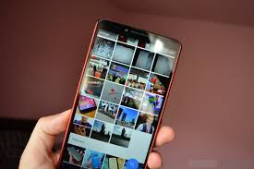
Problem Statement
Eliminate Scrolling of photos in gallery for searching

Slide 4
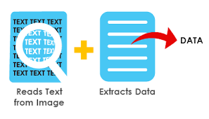
Overview
Our main objective is to remove conventional way of manual searching of photos in the gallery.

Slide 5
Conventional photo search method
Add Images
Gallery
View Images
Search

Slide 6
Disadvantages:-
Time consuming.
Very tedious.
Eye-straining.
USER GALLERY
May or may not find photo
Manual Search

Slide 7


Solution
Understand keywords entered by user and search that keyword in images

Slide 8

User Gallery

Slide 9
User Gallery
Search keyword from user

Slide 10
User Gallery
ML MODEL
Search keyword from user

Slide 11
User Gallery
ML MODEL
Suitable Image
Search keyword from user

Slide 12
Future Scope
Can be extended onto hand-written text.
Classification of images on different basis.
Storing data in a more effective way.
Digital Libraries(Reducing Paper consumption).
Audit and manage mismatch.(Banking Domain)
Translatability

Slide 13
Thank you

